Slide 1

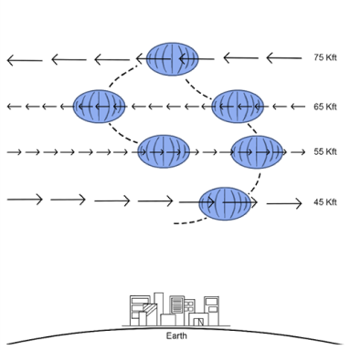
Historical Meteorological High-Altitude Wind Diversity Analysis for Aerial Platforms
Tristan Schuler¹, Craig Motell²
¹Distributed Autonomous Systems Group
Adaptive Systems Section (Code 5517)
U.S. Naval Research Laboratory
tristan.schuler@nrl.navy.mil
²???
???
Naval Information Warfare Center Hawaii
Craig.e.motell.civ@u.s..navy.mil
HAWG
Dec 6, 2023
Notes:
<number>

Slide 2
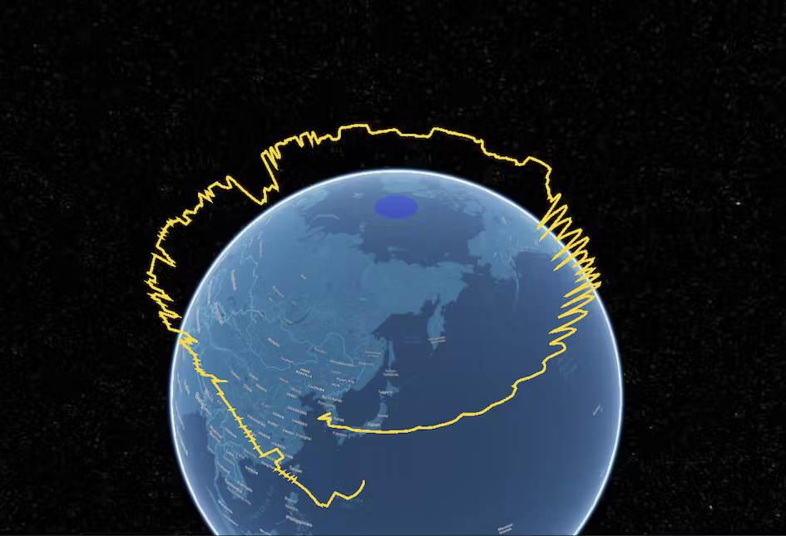

Introduction
Why is this historical wind analysis important?
Many High Altitude Platforms utilize or avoid certain winds for controllability in
High Altitude balloons can use opposing and/or calm winds for station keeping and trajectory following
Solar Planes look for calm or winds blowing in the path of flight to improve efficiency
Historical Wind Diversity Analysis | <number>

Slide 3
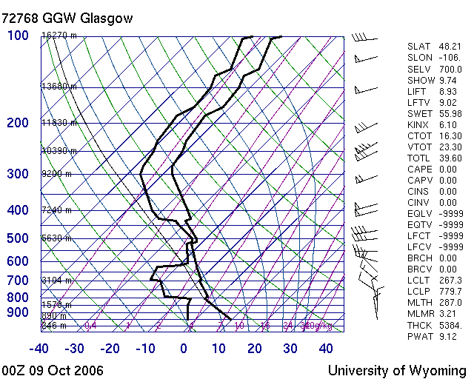
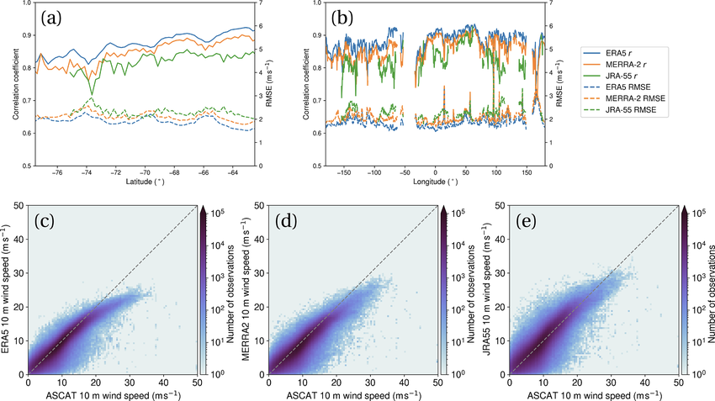
Problems with using Global Forecasts for Wind Diveristy Analysis
Vertical resolution decreases with an increase in altitude in Global forecasts. (Can be several km gaps in data)
Comparing soundings to forecasts shows there is a lot of wind shifts in those gaps.
QUESTION: Are there Global Forecasts (Gov or Public) with higher resolution?
Historical Wind Diversity Analysis | <number>

Slide 4
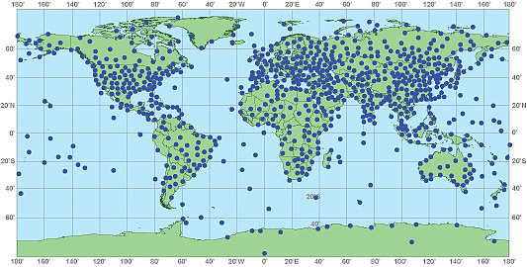
Batch Analysis of Global Radiosonde Data
There are over 2000 weather stations across every continent that regularly launch radiosondes for assimilation into global forecast models
We are currently developing software to bulk download locally and perform batch analysis of global sounding data
Currently, we have downloaded and analyzed over 1.5 million soundings in North America for the past decade [2012-2023] to perform historical wind diversity analysis
Historical Wind Diversity Analysis | <number>

Slide 5
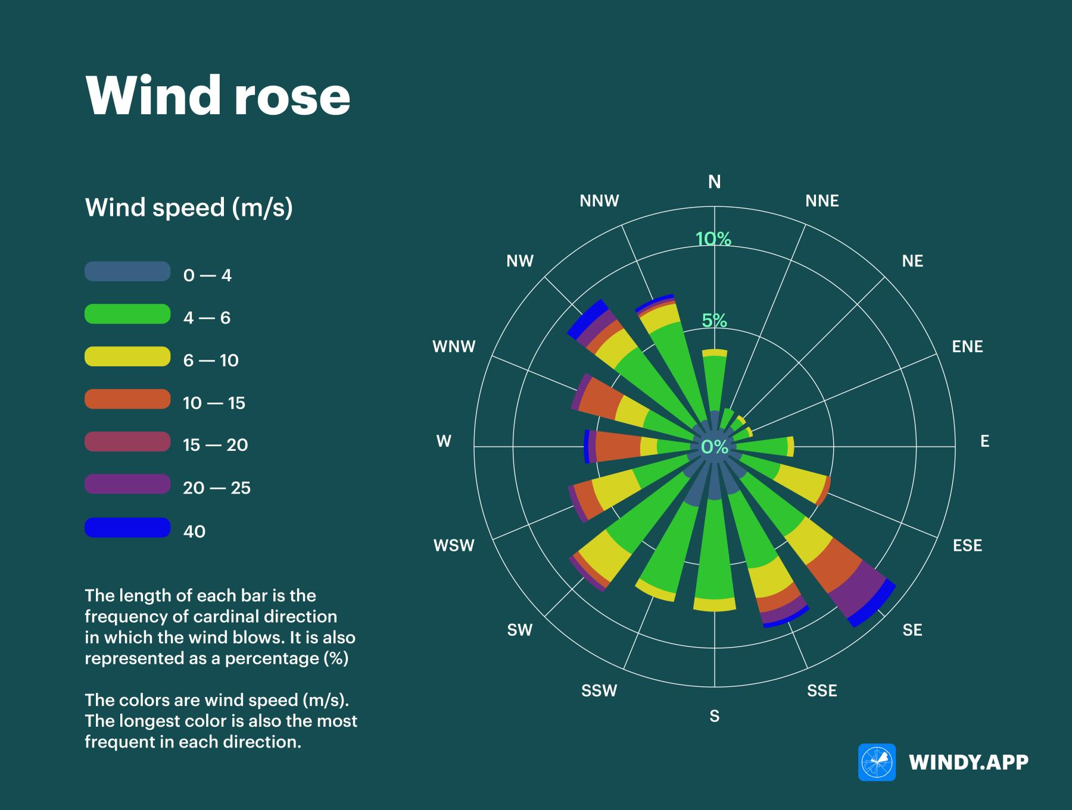
How to Read a Traditional Wind Rose
Historical Wind Diversity Analysis | <number>

Slide 6
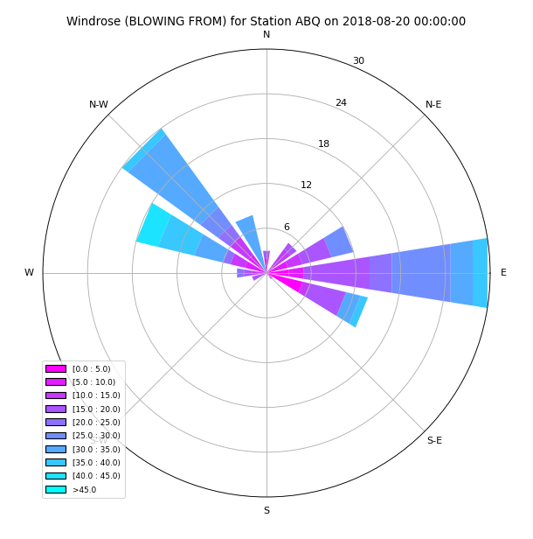
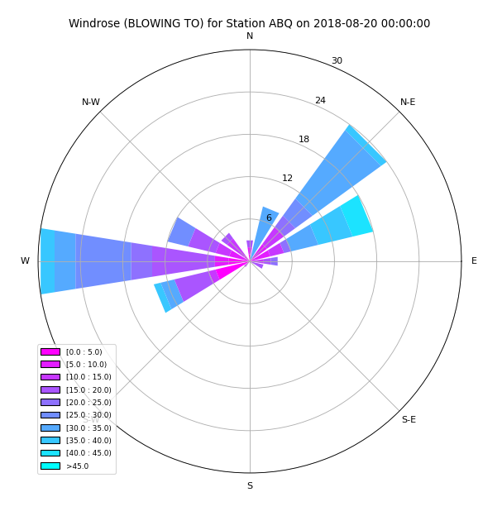

Modifying Wind Roses (Going forward)
For data analysis we are changing from a traditional wind rose (BLOWING FROM) to a mathematical vector-based representation (BLOWING TO) for physics-based and numerical simulation
(BLOWING FROM)
(BLOWING TO)
Historical Wind Diversity Analysis | <number>

Slide 7
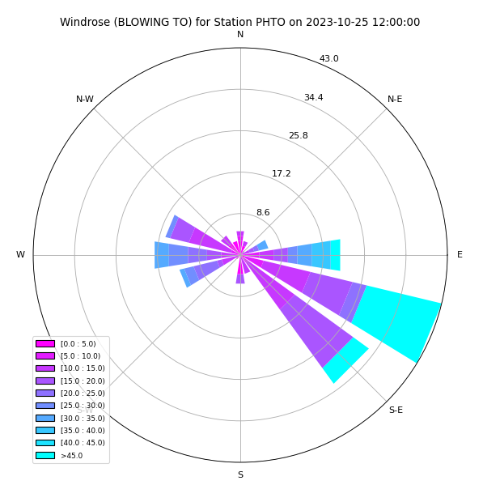
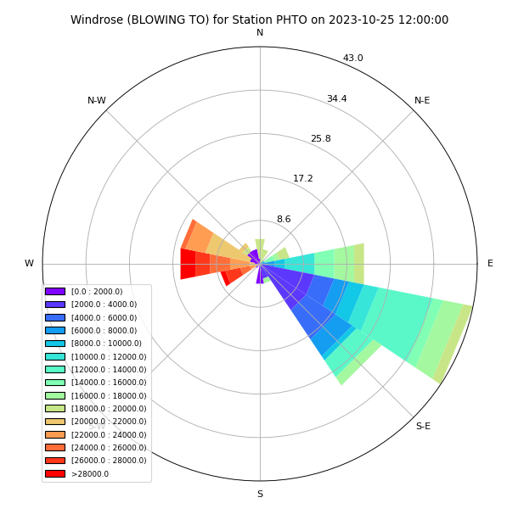
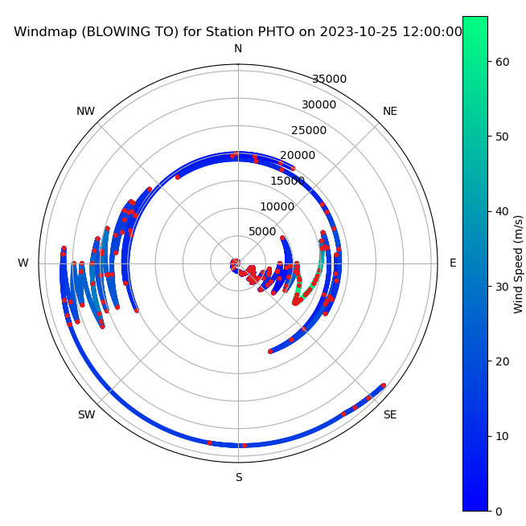
3 Ways to visualize the same sounding
SPEED FREQUENCY
ALT FREQUENCY
“3D” POLAR WIND PLOT
[standard “blow to” wind rose]
Historical Wind Diversity Analysis | <number>

Slide 8
Wind Diversity Analysis for HABs (15-25 km)
4 CATEGORIES for WIND DIVERSITY:
Fail, No Opposing winds
Calm winds (altitude region with winds <2 knots)
Opposing Winds (16-sector freq. analysis, at least 1 pair of opposing sectors)
Full Wind Diversity (8-sector freq. analysis, Either N-E-S-W or NE-SE-SW-NW)
Historical Wind Diversity Analysis | <number>

Slide 9
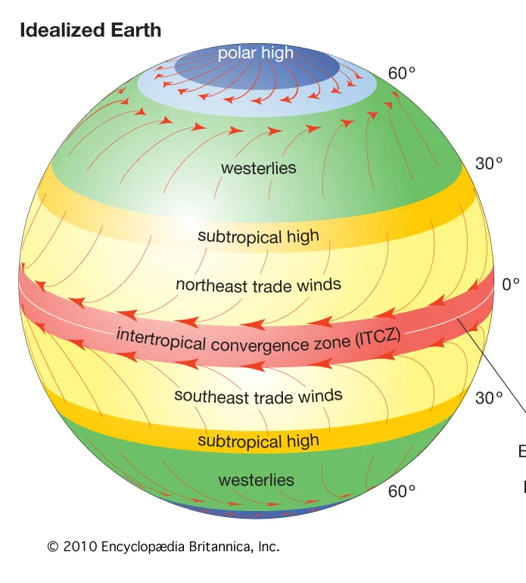
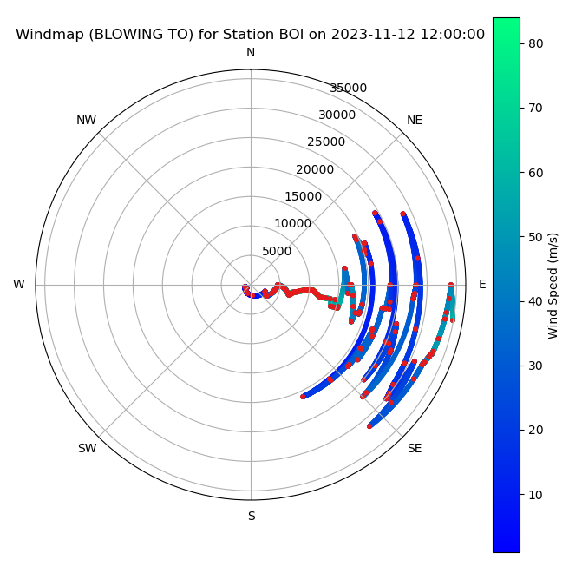
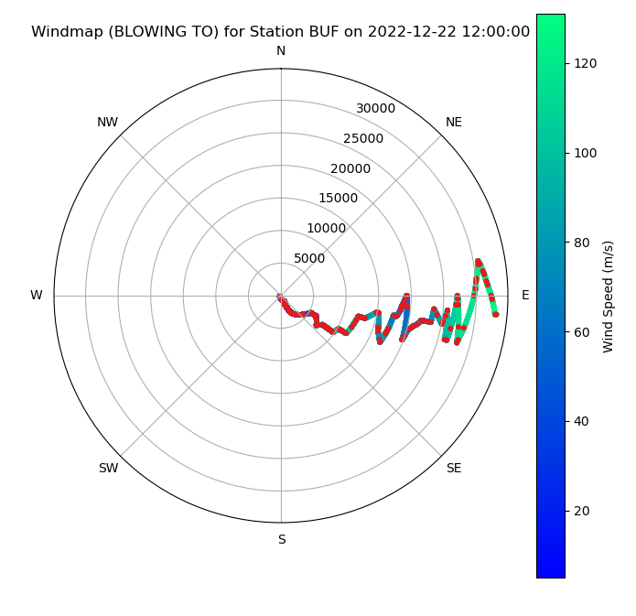
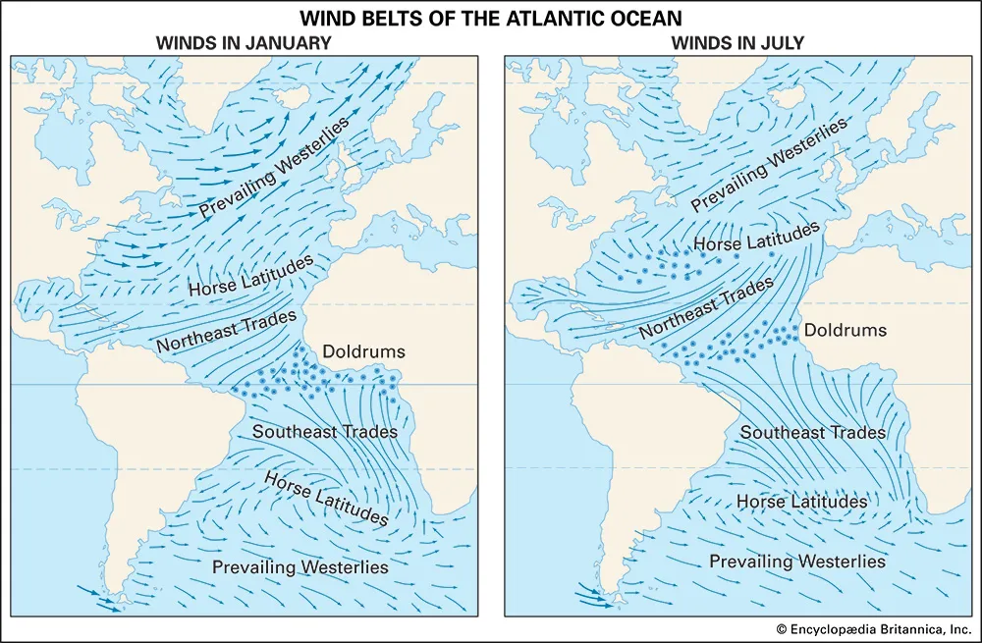
Wind Diversity Analysis for HABs (15-25 km)
Fail, No Opposing winds
Typical in the continental USA throughout the winter months (Nov-Mar) when the subtropical jet stream dominates
Historical Wind Diversity Analysis | <number>
https://www.weather.gov/source/zhu/ZHU_Training_Page/winds/Wx_Terms/Flight_Environment.htm

Slide 10
Wind Diversity Analysis for HABs (15-25 km)
Calm winds (altitude region with winds <2 knots)
QUESTION: What speed would you consider calm winds for aerial platforms
Historical Wind Diversity Analysis | <number>

Slide 11
Wind Diversity Analysis for HABs (15-25 km)
Opposing Winds (16-sector freq. analysis, at least 1 pair of opposing sectors)
QUESTION: Should there be additional parameters for labeling opposing winds?
Could there be a scale/ranking of Opposing winds?
Historical Wind Diversity Analysis | <number>

Slide 12
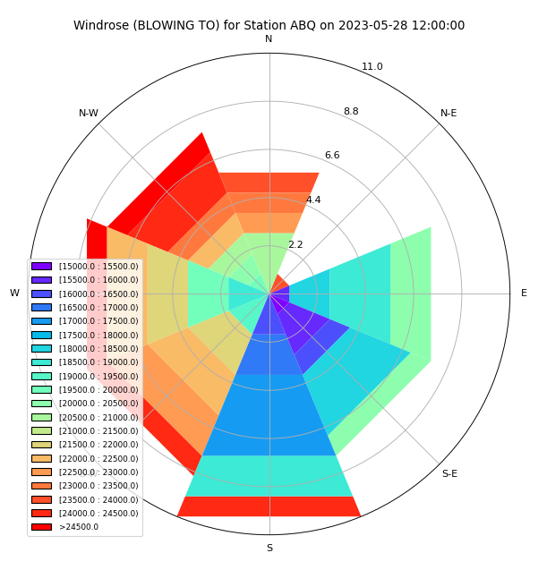
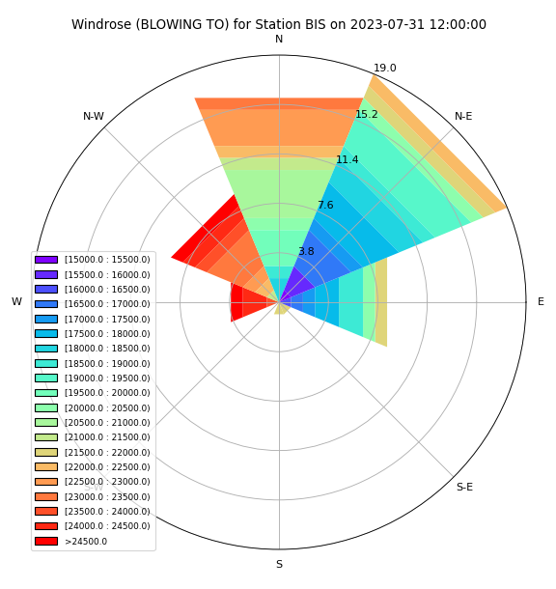
Wind Diversity Analysis for HABs (15-25 km)
Full Wind Diversity (8-sector freq. analysis, Either N-E-S-W or NE-SE-SW-NW)
Not all full wind diversities are equivalent
An ideal plot would have all sectors of equal size, and each one a different color)
This small southerly wind sector at 21.5 km passes the full wind diversity test
Great full wind diversity
Poor full wind diversity
Historical Wind Diversity Analysis | <number>

Slide 13
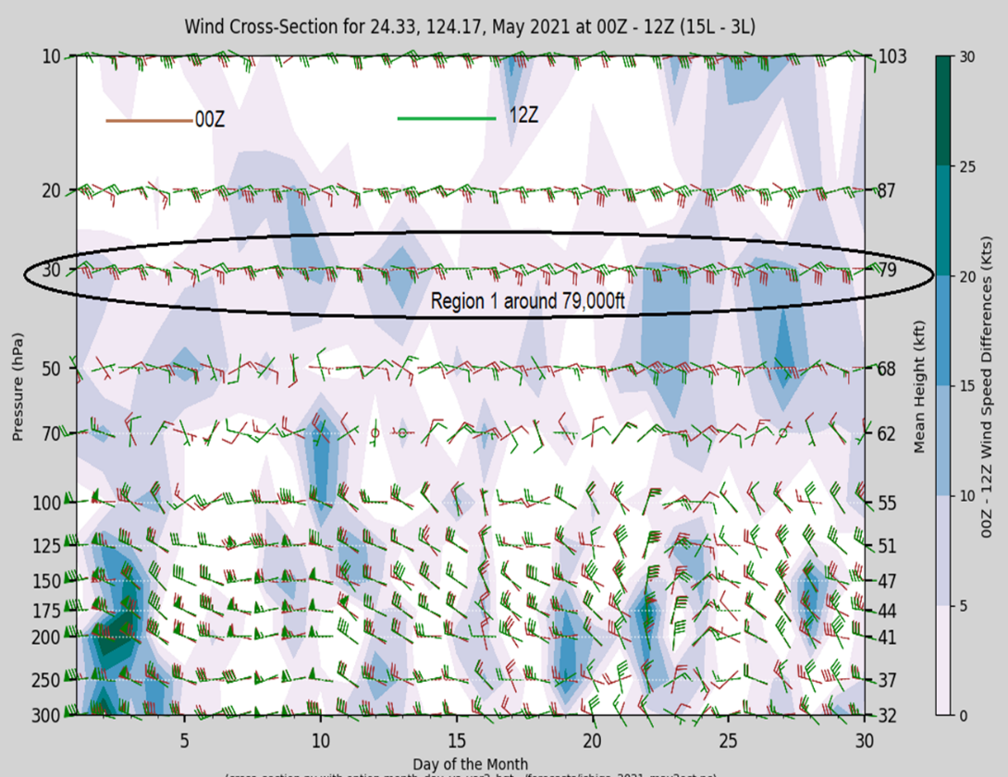
Additional Obesevations
Diurnal Wind Changes
CRAIG, we need to change the location of this plot
Historical Wind Diversity Analysis | <number>

Slide 14
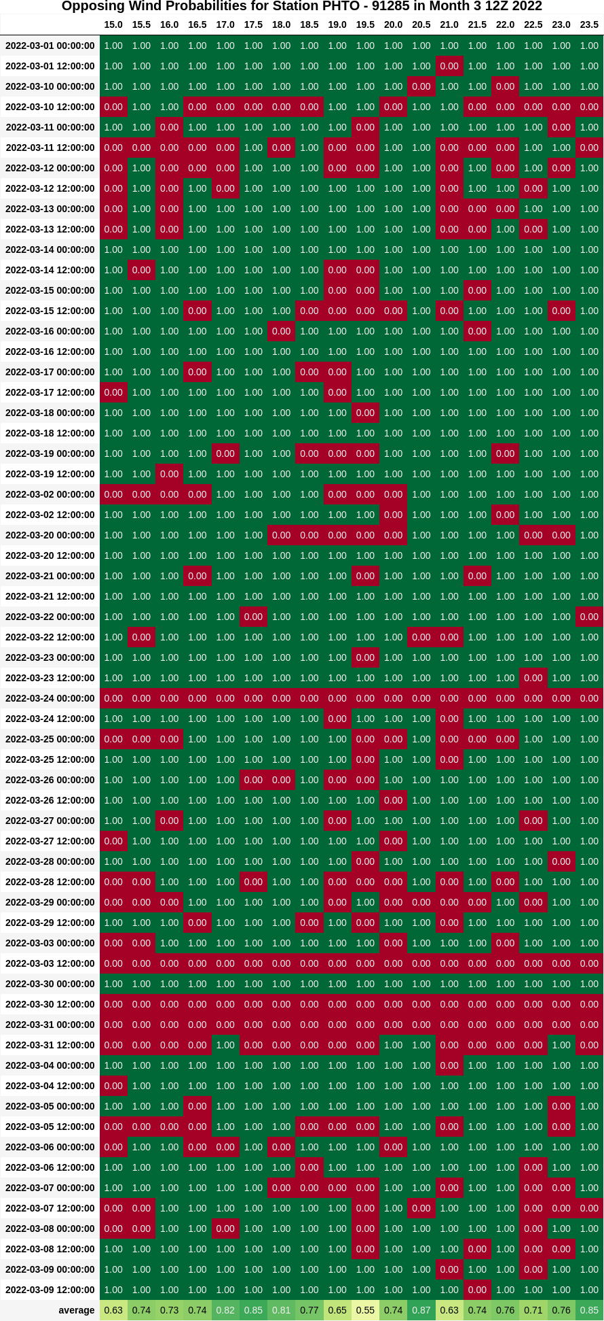
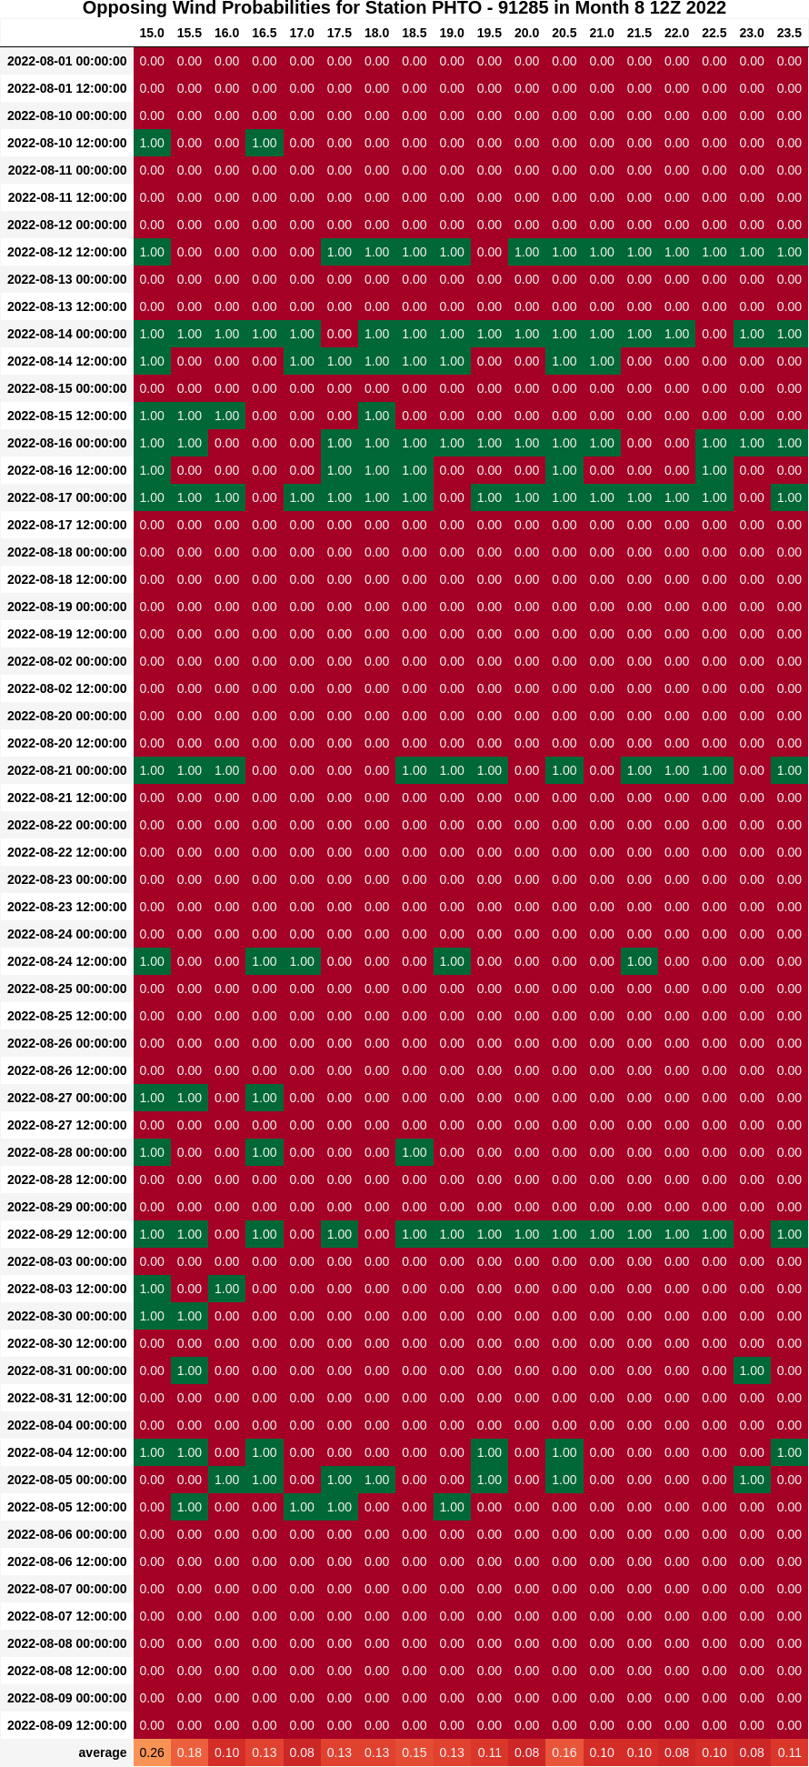
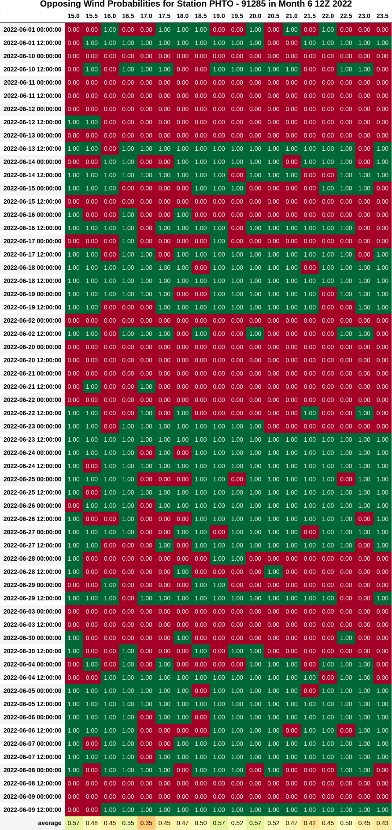
Opposing Winds Monthly Probabilities
Typically ~60 soundings per month per station
More when tracking weather phenomenon (hurricane, cyclone, vortex, etc.)
Sounding Timestamp
Altitude
Calculate the average probability at each altitude level in a given month
Historical Wind Diversity Analysis | <number>

Slide 15
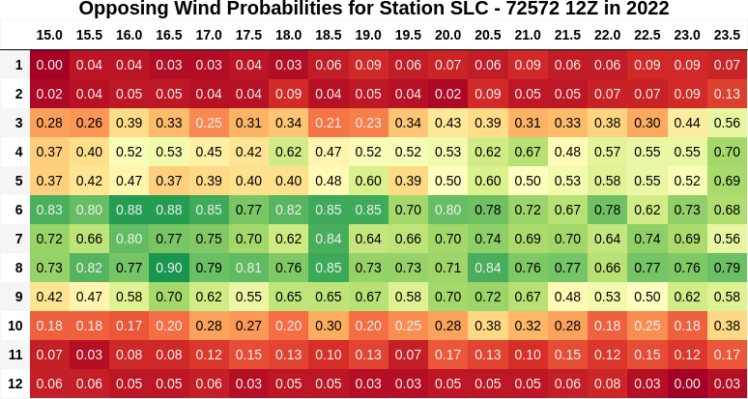
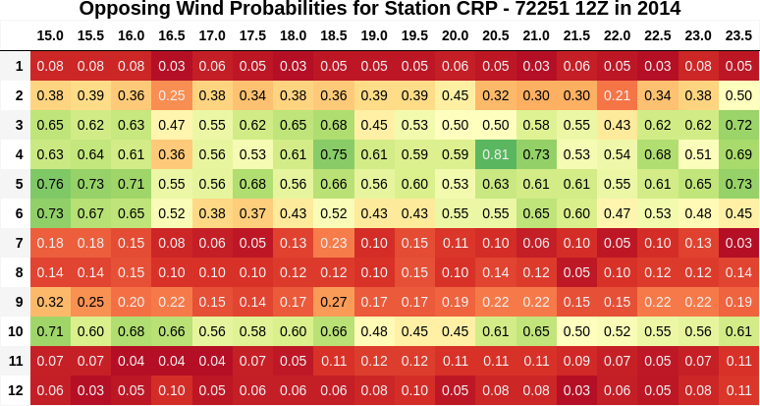
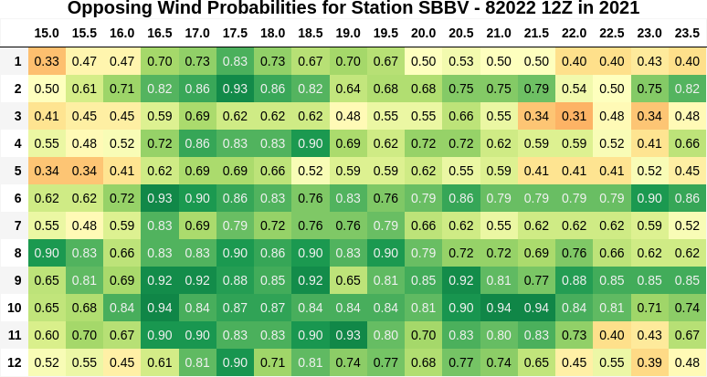
Opposing Wind Annual Probabilities
Salt Lake City (2022)
Corpus Christi (2014)
Boa Vista, Brazil (2021) [Near Equator]
Historical Wind Diversity Analysis | <number>

Slide 16
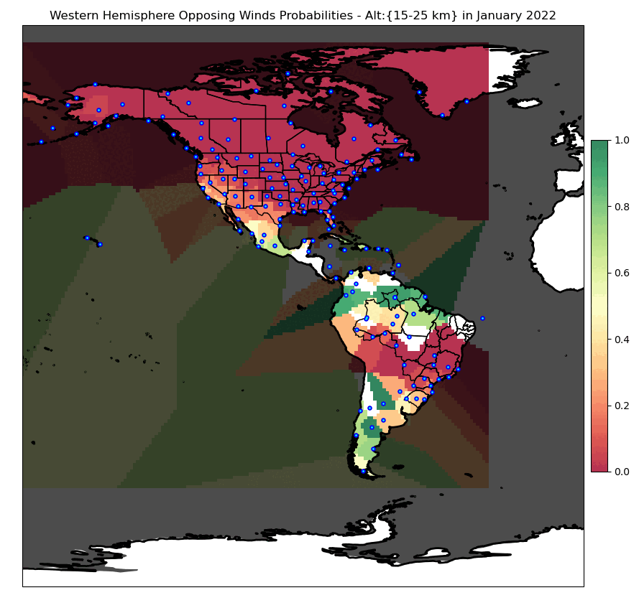
Western Hemisphere Wind Diversity in 2022
Historical Wind Diversity Analysis | <number>

Slide 17
Global Climatalogical effects Effects
El Nino, La Nina?
Coriolis Effects?
Climate Change
Hurricane Season,
Polar Vortex?
Etc.
Historical Wind Diversity Analysis | <number>

Slide 18
Questions?

